Slide 1



revenue_AdventureWorks
View in Power BI
Last data refresh:
3/28/2026 6:42:41 PM UTC
Downloaded at:
3/28/2026 6:47:54 PM UTC

Slide 2
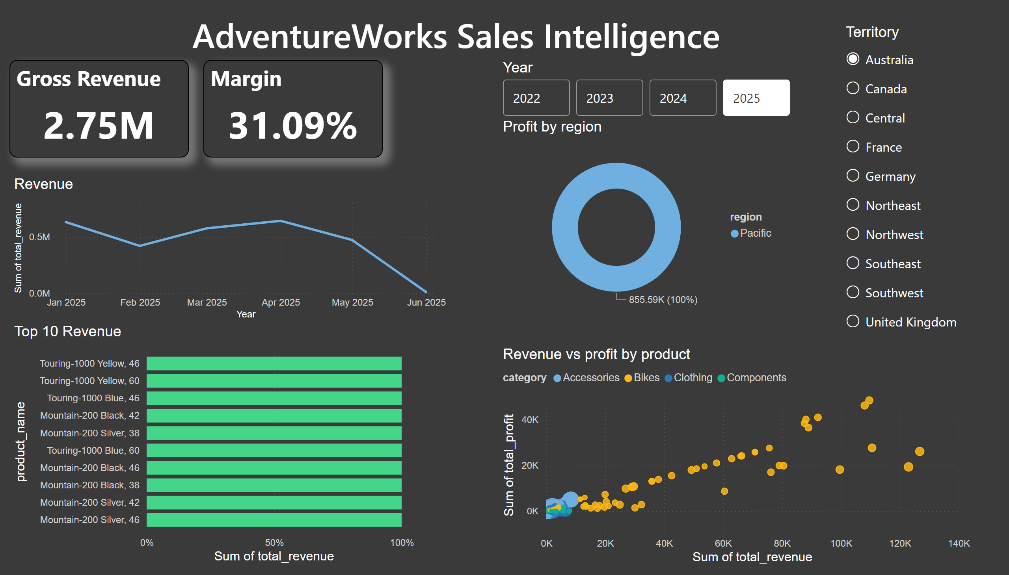
Page 1
Notes:
Top 10 Revenue
No alt text provided
Revenue
No alt text provided
advancedSlicerVisual
No alt text provided
Territory
No alt text provided
Revenue vs profit by product
No alt text provided
Profit by region
No alt text provided
Gross Revenue
No alt text provided
Margin
No alt text provided
AdventureWorks Sales Intelligence
No alt text provided

